Slide 1
No-SQL Data Models

Slide 2
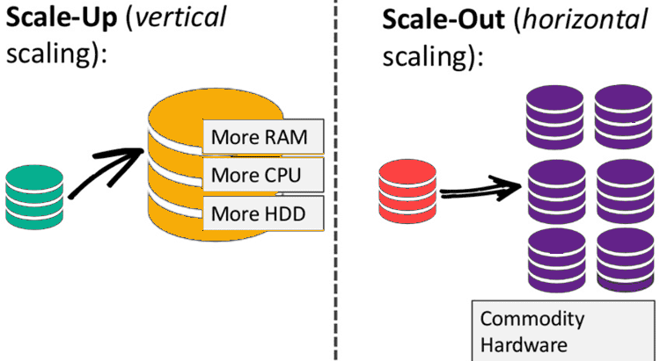
Notes:
As NoSQL Database uses distributed storage, it is easy to scale them up horizontally with commodity hardware. In the RDBMS world, the system tends to go slow when the volume of the data increases and could be tackled by scaling up the existing hardware. However, this process is expensive and inefficient. An alternative to this problem is distributing the data load to separate commodity hardware whenever the load increases.

Slide 3
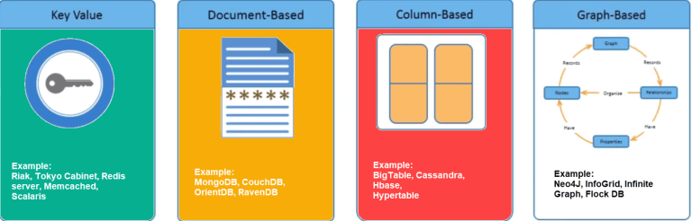

Slide 4
Key Value Store
In the Key Value store type, a hash table is used in which a unique key points to an item.
Keys can be organized into logical groups of keys, only requiring keys to be unique within their own group. This allows for identical keys in different logical groups.
The following table shows an example of a key-value store, in which the key is the name of the city, and the value is the address for Ulster University in that city.
Key | Value
"Belfast" | {“University of Ulster, Belfast campus, York Street, Belfast, BT15 1ED”}
“Coleraine" | {“University of Ulster, Coleraine campus, Cromore Road, Co. Londonderry, BT52 1SA”}

Slide 5
Document Store
Document stores are like key value stores in that they are schema-less and based on a key-value model.
Therefore, share many of the same advantages and disadvantages. Both lack consistency on the database level, which makes way for applications to provide more reliability and consistency features.
In Document Stores, the values (documents) provide encoding for the data stored. Those encodings can be XML, JSON, or BSON (Binary encoded JSON).
A document is a record in a document database. A document typically stores information about one object and any of its related metadata.

Slide 6
{
"_id": 1,
"first_name": "Tom",
"email": "tom@example.com",
"cell": "765-555-5555",
"likes": [
"fashion",
"spas",
"shopping"
],
"businesses": [
{
"name": "Entertainment 1080",
"partner": "Jean",
"status": "Bankrupt",
"date_founded": {
"$date": "2012-05-19T04:00:00Z"
}
},
{
"name": "Swag for Tweens",
"date_founded": {
"$date": "2012-11-01T04:00:00Z"
}
}
]
}

Slide 7
Collections
A collection is a group of documents. Collections typically store documents that have similar contents.
Not all documents in a collection are required to have the same fields, because document databases have a flexible schema. Note that some document databases provide schema validation, so the schema can optionally be locked down when needed.
Notes:
Continuing with the example above, the document with information about Tom could be stored in a collection named users. More documents could be added to the users collection in order to store information about other users. For example, the document below that stores information about Donna could be added to the users collection.

Slide 8
Key Features of Document Databases
Document model: Data is stored in documents (unlike other databases that store data in structures like tables or graphs). Documents map to objects in most popular programming languages, which allows developers to rapidly develop their applications.
Flexible schema: Document databases have a flexible schema, meaning that not all documents in a collection need to have the same fields. Note that some document databases support schema validation, so the schema can be optionally locked down.
Distributed and resilient: Document databases are distributed, which allows for horizontal scaling (typically cheaper than vertical scaling) and data distribution. Document databases provide resiliency through replication.
Querying through an API or query language: Document databases have an API or query language that allows developers to execute the CRUD operations on the database. Developers have the ability to query for documents based on unique identifiers or field values.

Slide 9
Column Store
In a Column Store database, data is stored in columns, as opposed to being stored in rows as is done in most relational database management systems.
A Column Store is comprised of one or more Column Families that logically group certain columns in the database.
A key is used to identify and point to a number of columns in the database, with a keyspace attribute that defines the scope of this key.
Each column contains tuples of names and values, ordered and comma separated.
Column Stores have fast read/write access to the data stored. In a column store, rows that correspond to a single column are stored as a single disk entry. This makes for faster access during read/write operations.
The most popular databases that use the column store include Google’s BigTable, HBase, and Cassandra

Slide 10
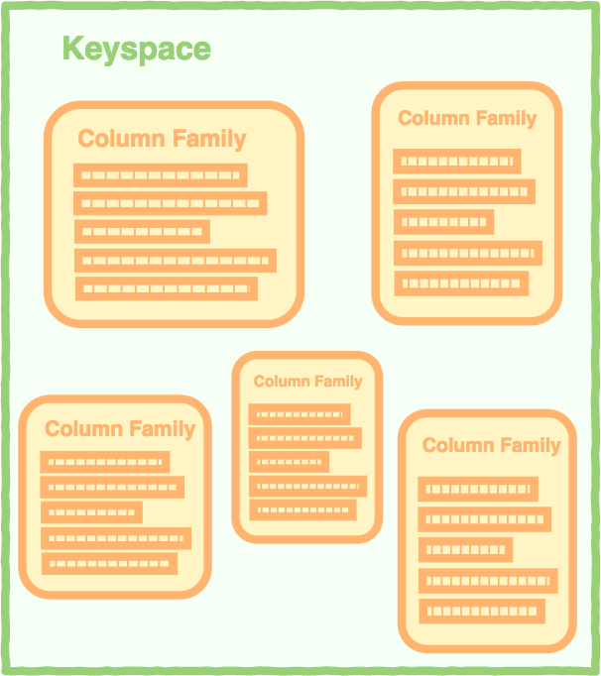

Slide 11
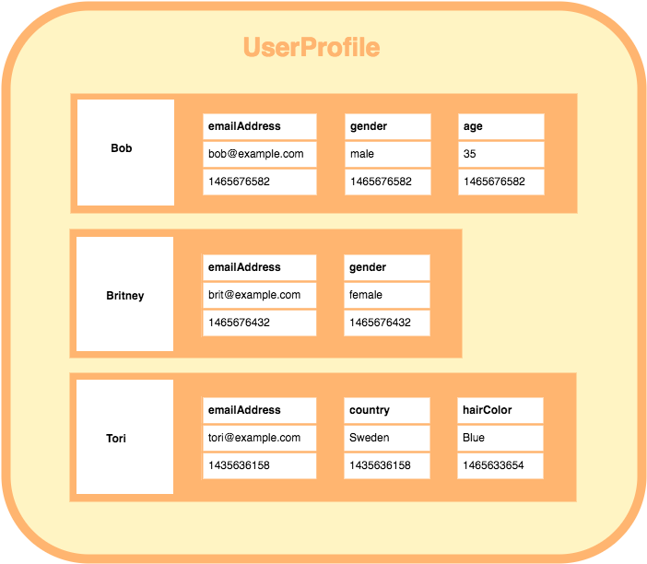


Notes:
A column family containing 3 rows. Each row contains its own set of columns.
As the above diagram shows:
A column family consists of multiple rows.
Each row can contain a different number of columns to the other rows. And the columns don’t have to match the columns in the other rows (i.e. they can have different column names, data types, etc).
Each column is contained to its row. It doesn’t span all rows like in a relational database. Each column contains a name/value pair, along with a timestamp. Note that this example uses Unix/Epoch time for the timestamp.

Slide 12
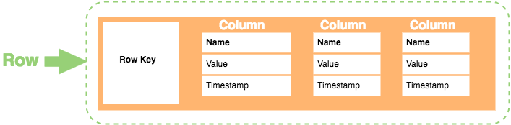
Here’s a breakdown of each element in the row:
Row Key. Each row has a unique key, which is a unique identifier for that row.
Column. Each column contains a name, a value, and timestamp.
Name. This is the name of the name/value pair.
Value. This is the value of the name/value pair.
Timestamp. This provides the date and time that the data was inserted. This can be used to determine the most recent version of data.

Slide 13
Benefits of Column Store Databases
Some key benefits of columnar databases include:
Compression. Column stores are very efficient at data compression and/or partitioning.
Aggregation queries. Due to their structure, columnar databases perform particularly well with aggregation queries (such as SUM, COUNT, AVG, etc).
Scalability. Columnar databases are very scalable. They are well suited to massively parallel processing (MPP), which involves having data spread across a large cluster of machines – often thousands of machines.
Fast to load and query. Columnar stores can be loaded extremely fast. A billion row table could be loaded within a few seconds. You can start querying and analysing almost immediately.

Slide 14
Column Oriented Database: Features
Multidimensional key store
Persistent in nature
Distributed
High flexibility
Pros:
– Supports semi-structured data
– Naturally indexed
– Scalable
Cons:
– Not suitable for relational data

Slide 15
Column Based Databases: Use Case:
User Preferences
Business Intelligence
Managing data warehouses
Reporting Systems

Slide 16

Graph Base
In a Graph Base NoSQL Database, a directed graph structure is used to represent the data. The graph is comprised of edges and nodes.
Formally, a graph is a representation of a set of objects, where some pairs of the objects are connected by links.
The interconnected objects are represented by mathematical abstractions, called vertices, and the links that connect some pairs of vertices are called edges. A set of vertices and the edges that connect them is said to be a graph.
Graph databases are most typically used in social networking applications. Graph databases allow developers to focus more on relations between objects rather than on the objects themselves. In this context, they indeed allow for a scalable and easy-to-use environment.

Slide 17
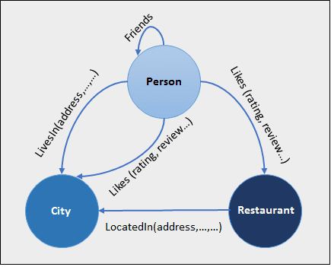
Graph databases are optimized for traversing through connected data, e.g. traversing through a list of contacts on your social network to find out the degree of connections.
Graph databases usually come with a flexible data model, which means there is no need to define the types of edges and vertices.
The Graph database can be used in social media, fraud detection, and knowledge graphs. Examples of Graph Databases are – Neo4J, Infinite Graph, OrientDB, FlockDB, etc.

Slide 18
Graph Databases: Features:
Flexibility
Agility
Improved performance, even with huge volumes of data.
Pros:
– Extremely powerful
– Connected data is locally indexed
– Can provide ACID
– Results in real-time
– Agile Structure
Cons:
– Difficult to scale out, though can scale up

Slide 19
Advantages of NoSQL Databases
NoSQL database is optimum for processing massive volume data with distributed processing.
NoSQL database supports failover mechanisms and ensures high availability.
NoSQL database provides easy replication along with horizontally scalable capability.
NoSQL database is capable of handling structured, semi-structured, and unstructured data.
NoSQL databases can be installed on commodity hardware and can form clusters for distributed processing.
NoSQL database offers flexible schema and can be changed at runtime without service downtime.

Slide 20
Disadvantages of NoSQL Databases
NoSQL databases have limited query capabilities as compared to RDBMS.
NoSQL databases don’t offer any RDBMS capabilities like consistency and ACID transactions.
Most of the NoSQL databases use key-value pairs to store the data. Hence it isn’t easy to maintain as the volume increases.
NoSQL databases are new to the markets and can be challenging for RDBMS programmers to switch to these technologies.
Most of the NoSQL databases are open source and are a restricted choice for enterprises.

Slide 21
CAP Theorem
The CAP Theorem is comprised of three components (hence its name) as they relate to distributed data stores:
Consistency. All reads receive the most recent write or an error.
Availability. All reads contain data, but it might not be the most recent.
Partition tolerance. The system continues to operate despite network failures (ie; dropped partitions, slow network connections, or unavailable network connections between nodes.)
Notes:
In normal operations, your data store provides all three functions. But the CAP theorem maintains that when a distributed database experiences a network failure, you can provide either consistency or availability.
Network partition means there is a break in the network or there is no connection between the data stores or the nodes. So the scenario where there is a break between different node in a disctributed data store is called parttion tolerance.
It is nothing but no data replication for a particular node or may be group of nodes or we can call it isolated data that way your database is isolated from other databases in the distributed system because there is a parttion tolerance.
Consistency
Consistency means that all clients see the same data at the same time, no matter which node they connect to. For this to happen, whenever data is written to one node, it must be instantly forwarded or replicated to all the other nodes in the system before the write is deemed ‘successful.’
Same example every user gets the same data from the datastore irrespective of the node from which thet are acquiring from this called consistency
If at a time multiple users place a query they will get the same data that is consistency same data
Availabiltiy
Availability means that that any client making a request for data gets a response, even if one or more nodes are down. Another way to state this—all working nodes in the distributed system return a valid response for any request, without exception.
Image there is a partion tolerance
User in the left side updates the datastore , right side user is retrieving that data from different datastore he wont see the same data. However the system does not fails. So there is inconsistent data across the the network however the system didn’t fail though therr was a network parttion. The system was still available
to serve the data this is called availability. This is called CAP availabity.
Some data

Slide 22
It’s a tradeoff. All other times, all three can be provided. But, in the event of a network failure, a choice must be made.
In the theorem, partition tolerance is a must. The assumption is that the system operates on a distributed data store so the system, by nature, operates with network partitions. Network failures will happen, so to offer any kind of reliable service, partition tolerance is necessary—the P of CAP.
That leaves a decision between the other two, C and A. When a network failure happens, one can choose to guarantee consistency or availability:
High consistency comes at the cost of lower availability.
High availability comes at the cost of lower consistency.
Notes:
The moment in question is the user query. We assume that a user makes a query to a database, and the networked database is to return a value.
Whichever value is returned from the database depends on our choice to provide consistency or availability. Here’s how this choice could play out:
On a query, we can respond to the user with the current value on the server, offering a highly available service. If we do this, there is no guarantee that the value is the most recent value submitted to the database. It is possible a recent write could be stuck in transit somewhere.
If we want to guarantee high consistency, then we have to wait for the new write or return an error to the query. Thus, we sacrifice availability to ensure the data returned by the query is consistent
We can choose out of 3 principles
A distributed database system is bound to have partitions in a real-world system due to network failure or some other reason. Therefore, partition tolerance is a property we cannot avoid while building our system. So a distributed system will either choose to give up on Consistency or Availability but not on Partition tolerance
For example in a distributed system, if a partition occurs between two nodes, it is impossible to provide consistent data on both the nodes and availability of complete data. Therefore, in such a scenario we either choose to compromise on Consistency or on Availability. Hence, a NoSQL distributed database is either characterized as CP or AP. CA type databases are generally the monolithic databases that work on a single node and provide no distribution. Hence, they require no partition tolerance.

Slide 23
Today, NoSQL databases are classified based on the two CAP characteristics they support:
CP database: A CP database delivers consistency and partition tolerance at the expense of availability. When a partition occurs between any two nodes, the system has to shut down the non-consistent node (i.e., make it unavailable) until the partition is resolved.
AP database: An AP database delivers availability and partition tolerance at the expense of consistency. When a partition occurs, all nodes remain available but those at the wrong end of a partition might return an older version of data than others. (When the partition is resolved, the AP databases typically resync the nodes to repair all inconsistencies in the system.)
CA database: A CA database delivers consistency and availability across all nodes. It can’t do this if there is a partition between any two nodes in the system, however, and therefore can’t deliver fault tolerance.

